Slide 1

Campus Placement Analysis
By
Upender Taliyan
From batch: da614s61
Project guide: komilla bhatia

Slide 2
Business Problem
The institute is facing Student Placement Crisis:
A large number of students graduate without securing placements
No clarity on which factors actually improve placement chances
Huge variation in salary packages (CTC) with no explanation
Students invest time in wrong skills, unaware of recruiter expectations
Colleges cannot guide students effectively without data-backed insights

Slide 3
Business Objectives My Role as an analyst is to support the institute to achieve the following:-
A) Analyse Historical Data:-
Placement drives identify which factors increase chances of placement among "placed" students
CTC predictors identify which factors lead to higher salary (CTC_LPA) for placed students
B) Recommend Strategies:-
Improve placement suggest how "not placed" students can move to "placed“
Boosts salary and suggest which skill sets help students earn a higher CTC package

Slide 4
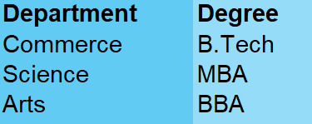
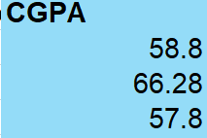
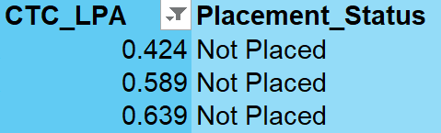
Dataset Description
The dataset contains the following 3 tables : Placement Record , Student Profile , Academic Skills
Real-World Data Challenges:-
The dataset was messy, inconsistent, and logically incorrect in some cases
The department did not mentioned the degree correctly
Below snapshots can demostrate the issues with the dataset:
Data Cleaning & Fixes Applied:-
Degree & Department Issues → Standardized using domain knowledge
Invalid CGPA Values → Corrected values greater than 10
Incorrect Placement Status→ Records with CTC > 0 but marked as Not Placed were corrected to Placed

Slide 5
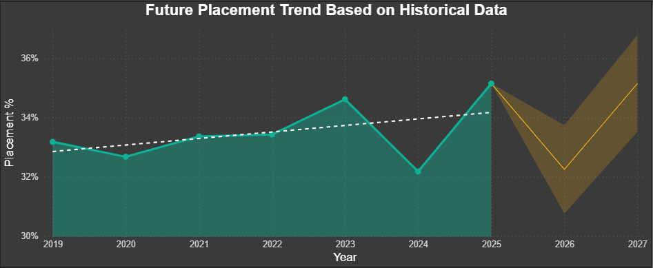
The above chart suggests that from 2025-2026, Placement will observe a sharp decline It also indicates that from 2026-2027 there will be an upward trend of placements.
FORECASTING FUTURE PLACEMENT PERCENTAGE

Slide 6

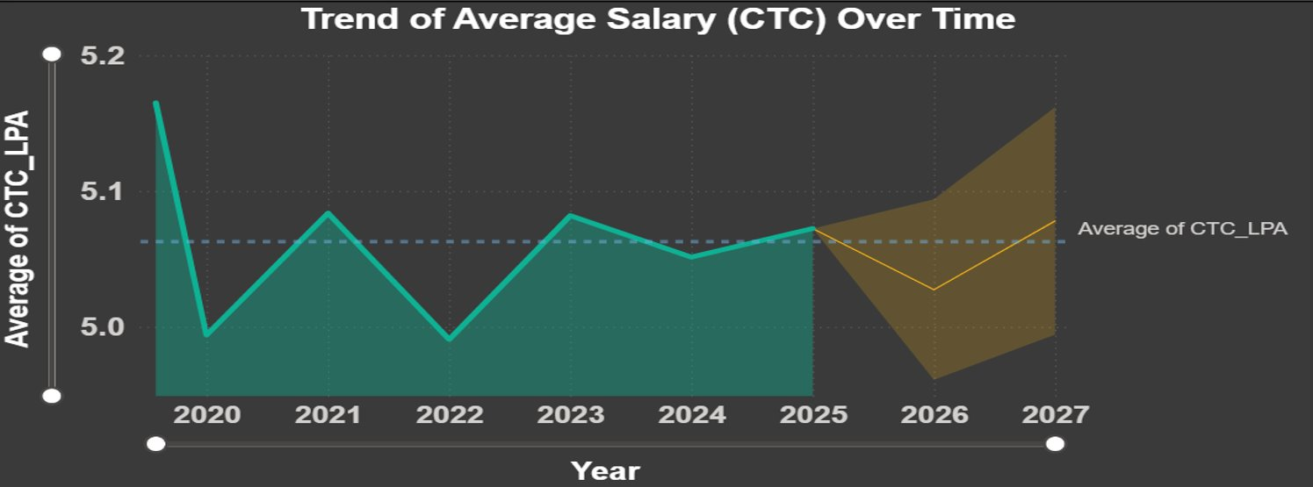
FORECASTING FUTURE CTC LPA
The above chart suggests that from 2025–2026, the average CTC will observe a notable decline.
It also indicates that from 2026–2027, there will be a strong upward trend of CTC

Slide 7
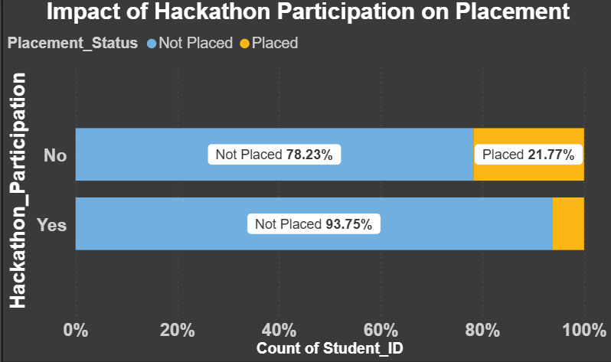
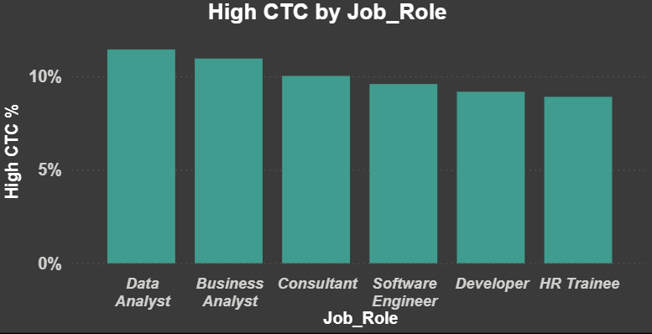
INSIGHT REGARDING PLACEMENT FACTORS
The charts suggest that hackathon participation does not positively impact placement, as non-participants have a significantly higher success rate (21.77%) than participants (6.25%).
The chart suggests that Data Analysts and Business Analysts lead in high CTC placements, both exceeding 10%. Conversely, roles like Consultant and Software Engineer show a steady decline, with HR Trainees receiving the lowest percentage of high-salary offers.

Slide 8
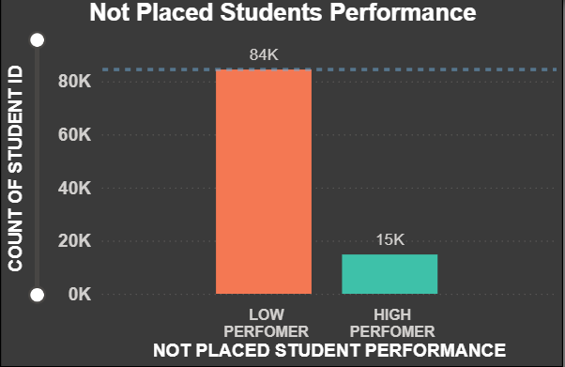
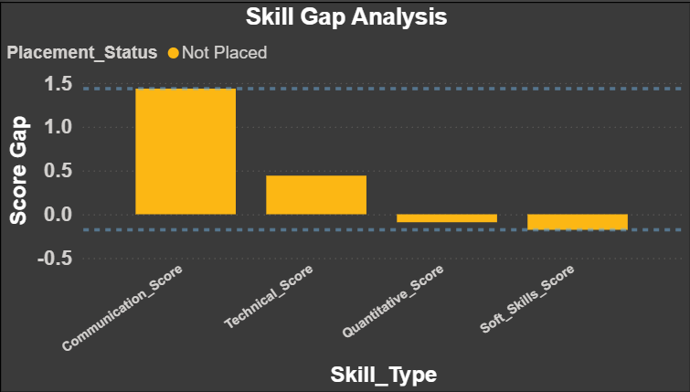
INSIGHTS REGARDING WHY STUDENTS ARE NOT GETTING PLACED
Not placed students can improve their chances of placement by improving their:
Communication Skills, Technical Skills, Working on more Projects
Recommendations:
More project boost chances of higher CTC
Better communcitation and technical score can lead to higher package

Slide 9
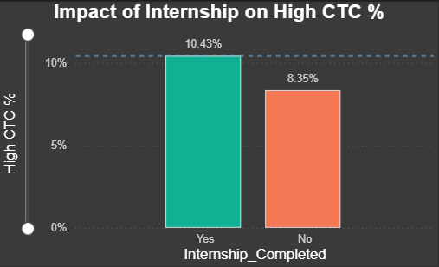
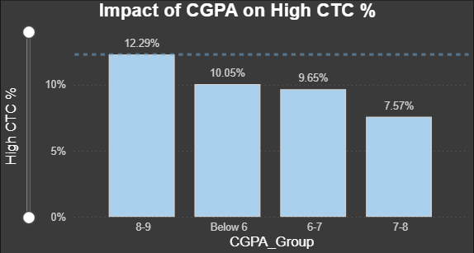
INSIGHTS ON WHICH STUDENTS RECEIVED HIGHER CTC
High CGPA improves salary outcomes
Internships boost chances of higher CTC
These factors help unplaced students achieve higher CTC

Slide 10
Statistical Approach
Statistics transformed raw student data into actionable placement insights:
Z-Test (Technical Score vs Placement)
Compared the average Technical Score of Placed vs Not Placed students to check if technical skills impact placement
Sample size of placed students was 5,938, and sample size of not placed students was 24,809
The average Technical Score:Placed students → around 62.82 , Not placed students → around 64.39
Conclusion: Higher technical scores do not guarantee placement, suggesting that other factors such as communication skills, internships, and projects also influence placement outcomes.
Chi-Square Test (Internship vs Placement)
Analyzed whether internship completion and placement status are related.
Students without internships: 2391 not placed, 1162 placed
Students with internships: 22418 not placed, 4776 placed
Conclusion: Students with internships are more likely to get placed compared to those without internships (≈ 1162 placed).
Notes:
Z-Test: There is a significant difference in Technical Scores (Z ≈ -9.20, p ≈ 3.5e-20), but higher technical scores do not guarantee placement (Avg Technical Score: Placed ≈ 62.82, Not Placed ≈ 64.39), showing that other factors also influence placement.
Chi-Test: A strong relationship exists (χ² ≈ 461, p ≈ 0.0), where students with internships (≈ 4776 placed) are significantly more likely to get placed compared to those without internships (≈ 1162 placed).

Slide 11
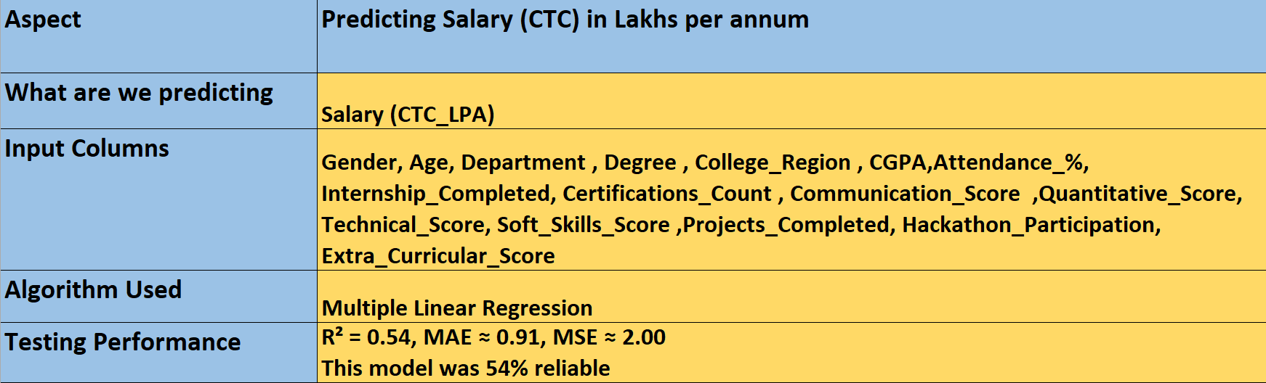
Machine Learning Regression Implementation
Add ss
Business Interpretation: Our regression ML models are able to predict:
what will be student's Salary(CTC) based on historical performance of the student

Slide 12
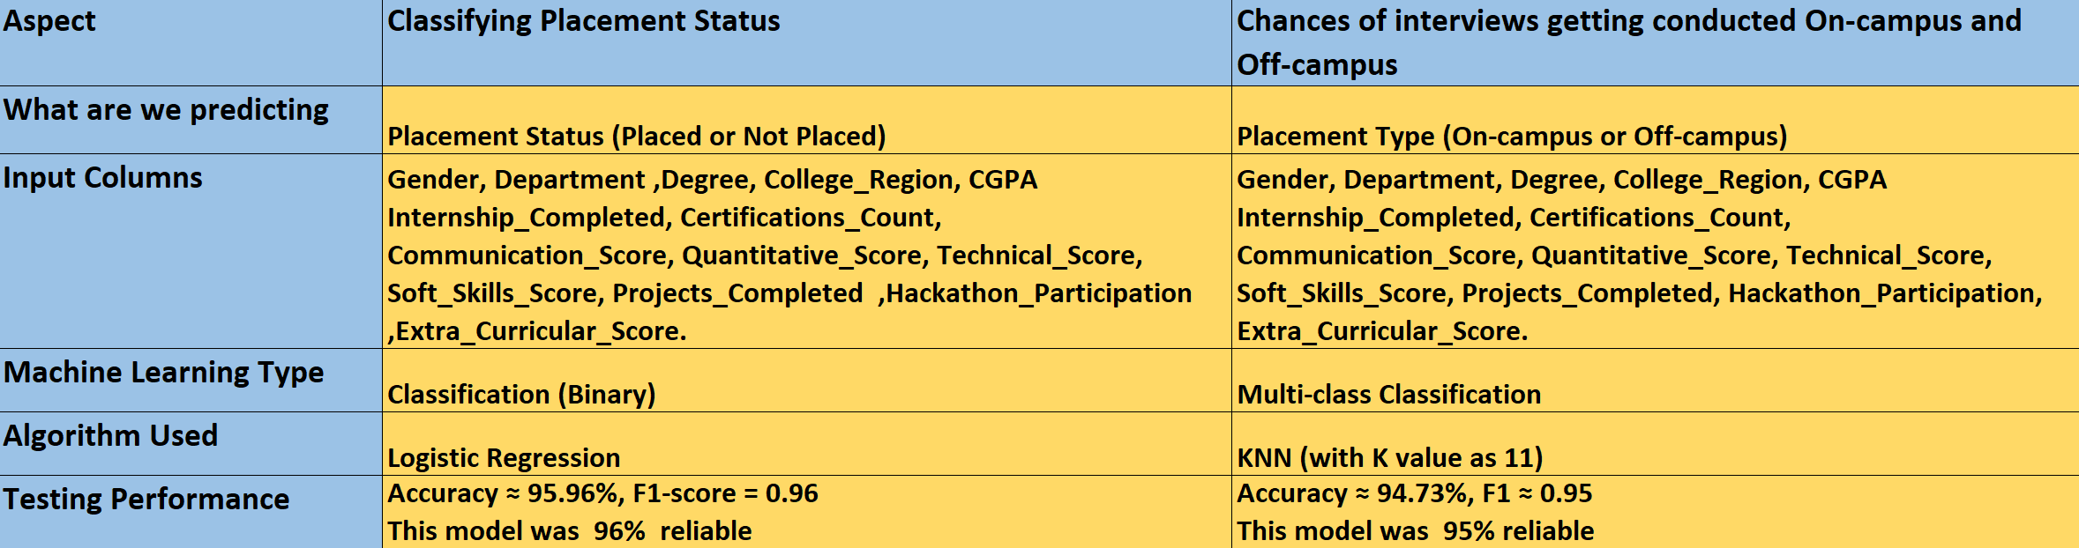
Machine Learning Classification Implementation
Business Interpretation: Our classification ML models are able to predict:
Whether a student will be placed or not in the future.
It can suggest if the chances of interviews getting conducted On-campus and Off-campus

Slide 13
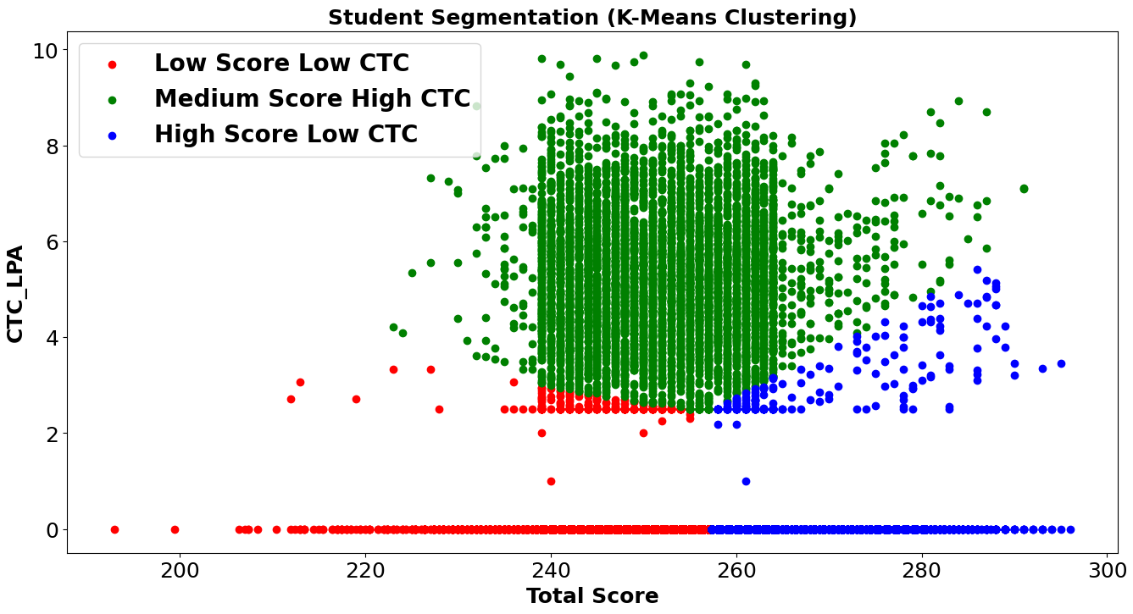
Predicting CTC using KMeans ML Algorithm
Observations from ML Model:
Red color represents:- Low Performance Low CTC
Green color represents:- Average Performance High CTC
Blue color represents:- High Performance Low CTC
Recommendations:
Academic Score is not enough for higher package , other skills also play an important role
Some High Scorers received low CTC which is represented by Blue color in the graph .
Input Columns: CTC_LPA and Total Score
Created by adding Attendance_%,Communication_Score,Quantitative_Score,Technical_Score,Soft_Skills_Score,Projects_Completed,Extra_Curricular_Score.
Notes:
Model performance was Silhouette Score : 55% which is an average model

Slide 14
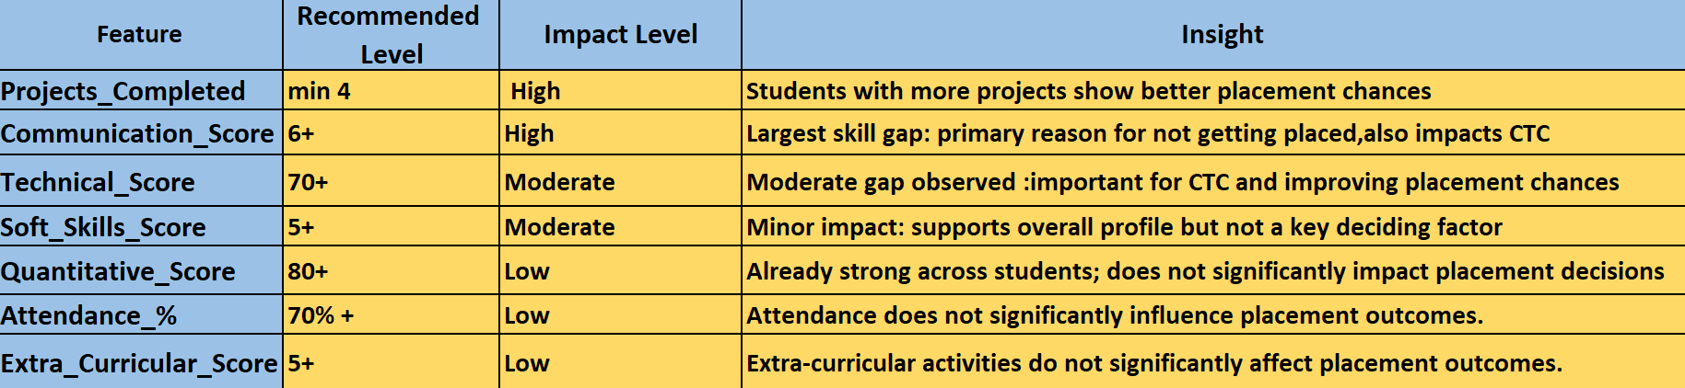
Summary
CTC will reduce little bit to 4.96 by the end of 2026 and will increase to 5.09 by end of 2027. Overall, maintaining an avg of 5.07 lakhs per annum.
Placement % will reduce from 2025-2026, and will increase in 2026-2027.
Impact on CTC and chances of getting PLACED:
due

Slide 15
Conclusion
Placement and CTC depend on both academic and practical factors:
Key success drivers for students:
Skills need to be greater than 5
Quantitative Score need to be greater than 80
Working on more Projects (Min 4)
Balanced profile need to be greater than 7
MInimum one Internship before placement
Job Roles like Data Analyst and Business Analyst lead higher salary opportunities.
Placement and ctc both will have a sharp decline from 2025-2026 so students are recommended to uItlize this one year period for upskilling themselves for Data Analyst and Business Analyst roles
From 2026-2027 there will be an upward trend of placements and ctc so students are expected to keep their preparation up to date

Slide 16
THANK YOU

